Slide 1
Coffee Chai Time and Annual General Meeting
Tuesday, November 2, 2021

Slide 2
Our time together – an overview
Coffee Chai Conversation
Theme: The cultural iceberg – the clergy collar
and
Annual General Meeting

Slide 3
AGENDA
Opening (Deborah Richards)
Welcome and Land Acknowledgement
Introductions and session overview
Prayer (Kurt Katzmar and Alwin Maben)

Slide 4
Coffee Chai Conversation
The cultural iceberg – the clergy collar
Topic Introduction (Chelsea Masterman)
Personal Reflections:
Rev. Lee Spice
Rev. Piotr (Peter) Strzelecki, VDM

Slide 5
Coffee Chai Conversation
Clarifying Questions
Small group discussion
What is your first memory of seeing someone in a clerical collar?
Do you or your minister wear a clerical collar? What does wearing, or not wearing the collar mean to you?
In the interest of increasing intercultural awareness – why is it important to be aware of the many ways in which others view the wearing of a clerical collar and/or other vestments?

Slide 6
Coffee Chai Conversation
Re-gathering in plenary, feedback
(Chelsea and Deborah)
What is one key insight from your small group?
Discussion wrap up

Slide 7
BREAK
(5 MINUTES)

Slide 8
Annual General Meeting
Key highlights from the past year
(Deborah Richards)
Review of TOR and mandate
(Kurt Katzmar)

Slide 9
Annual General Meeting
Network Executive
Deborah Richards (Pacific Mountain) and Rev Kurt Katzmar (Northern Spirit), co-chairs
Kathy Yamashita (Chinook Winds), secretary
Kay Quon (Chinook Winds), Elder
Pacific Mountain Region: Alwin Maben
Northern Spirit: Rev Chelsea Masterman
Living Skies: Rev Mathias Ross, Rev Salesi Takau ,
Prairie to Pine: Damber Khadka Rev Bill Millar
Staff support: Julie Graham (Northern Spirit/ Living Skies/ Prairie to Pine) and Chris Mah Poy (Chinook Winds and Pacific Mountain)

Slide 10
Annual General Meeting
Vacancies on the Executive:
1 representative for Chinook Winds
Expressions of Interest to join the WIMN Executive
(nominations can be sent to any current member of the Executive)

Slide 11
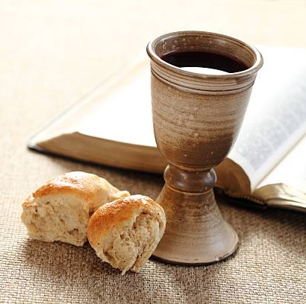
Communion

Slide 12
Invitation – Love and Relational feast
Friends, Jesus invites us to share meal together in this time.
Even though we cannot be together in person, we can be strengthened by this holy meal. We can find power in the breaking of the bread and the sharing of the cup of blessing.
Let's gather, though we are separate, and join the feast of love.

Slide 13
Prayer of Thanksgiving
God , in you we live , move and are fed, sweet, flowing milk, life givingbread.
Oh God bless this bread as a symbol of our oneness.
Let us break bread together in God's love that revealed in Jesus' life , work, death and risen! amen

Slide 14
Sharing the bread
Take your bread and eat . Do this in remembrance of the one who showed the one who showed us how to love one another. Amen.

Slide 15
Blessing of the cup
Lord, as we drink this wine, We remember that you are the giver of life.
You are forgiveness, you bring deep peace to our souls and your love flows within us.
As we pour out this wine, we see your sacrifice poured out for us.
We notice the depth of your goodness, and the pain you suffered for us.

Slide 16
We dwell upon the intricacy of human life, and the price you paid to set humanity free.
Yet just as the tombstone rolled away to unleash the risen Lord, your light shines in our hearts now, extinguishing all darkness to release heavens blessings upon us.
Thank you, Lord.
Amen.

Slide 17
Sharing of the Wine
After supper, Jesus took the cup, and poured, saying,
“This is the new covenant, remember me.”
We do remember.
We remember his life of love, his friendship, his teaching, his dying, and his rising to life again.

Slide 18
Prayer after Communion
Thank you, O Christ, for this feast of life.
We are fed by your love; we are strengthened by your life.
We are sent forth into this world to live into the visions
God has laid on our hearts. We are now commissioned to: feed as we have been fed, forgive as we have been forgiven, love as we have been loved.
Thanks be to God.
Amen.

Slide 19
Annual General Meeting
Closing Remarks
Adjournment

